Slide 1
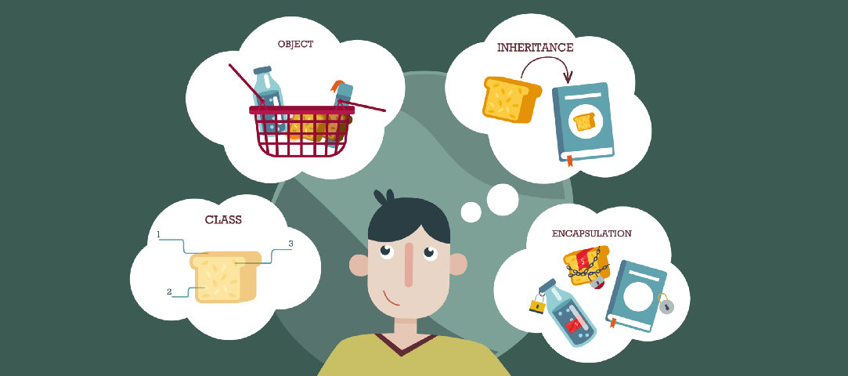
Lecture – 3.4 JAVA: Scanner Class
Afsara Tasneem Misha
Lecturer
Department of CSE
Daffodil International University

Slide 2
Today’s Topics
Taking input using Scanner class
Some exercises using scanner class

Slide 3
Taking input from User Scanner Class
‘Scanner’ class is used to take input from user
An object of Scanner class is created to read input
Java uses System.out to refer to the standard output device and System.in to standard input device
Import ‘java.util.Scanner’ package to use scanner class

Slide 4
Commonly used methods for Scanner class
nextByte(): reads an Byte value from the user
nextShort() : reads an Short value from the user
nextInt() : reads an int value from the user
nextLong() : reads an Long Integer value from the user
nextFloat() : reads an Float value from the user
nextDouble() : reads an Double value from the user
next() : reads a word from the user
nextLine() : reads a Line of Text from the user

Slide 5
Exercise Using Scanner class
Take two integer numbers as input and calculate their sum.
Calculate the area of a circle. Take radius as input.
Take some information about yourself (i.e. name, age, cgpa, department, section etc) as input and display them.

Slide 6
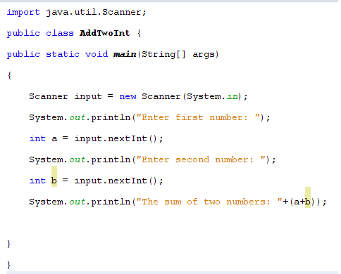

Slide 7
import java.util.*;
public class ScannerExample {
public static void main(String args[]){
Scanner in = new Scanner(System.in);
System.out.print("Enter your name: ");
String name = in.nextLine();
System.out.println("Name is: " + name);
}
}

Slide 8
Thank You

